Slide 1
Introduction to Git
Saifuddin Merchant

Slide 2
Git Overview
History
Workshop Objectives
Git Client(s) Ready?

Slide 3
Awesome Learning References
https://git-scm.com/book/en/v2
https://www.atlassian.com/git/tutorials/what-is-version-control
https://goo.gl/1rSELA - Introduction to Git by Scott Chacon
https://goo.gl/iGWLVj - video tutorial part 1 of 4 – workshop style
https://goo.gl/jVhEIu - Linus Torvalds on Git

Slide 4
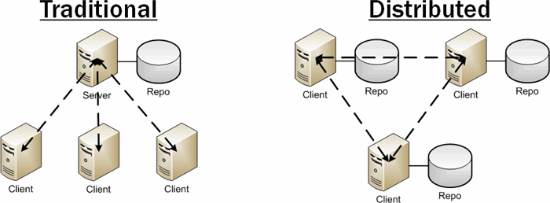
Git Concept: Distributed VCS
Distributed: Every developer is the client, the server, and the repository

Slide 5
TIY 1: Git Help & Global Config
Objectives
Getting Help
Global Configuration

Slide 6
TIY 2: Git Initialize and Clone
Objectives
Initialize a local repository
file structure - .git folder
Commit Files, View History
command: status
concept: staging area, commit area
Clone a remote repository

Slide 7
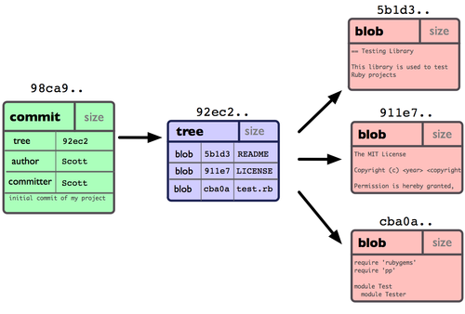
Git Concept – File Structure
git cat-file –p <filename>
Ref: https://git-scm.com/book/en/v2/Git-Internals-Git-Objects

Slide 8
TIY 3: Branching
Objectives
Learning how to create branches
Working with branches
Creating remote branches
Getting remote branches locally

Slide 9
TIY 4: Merging
Objectives
Merging Branches
Merge Conflicts
Fast Forward Merge
Three Way Merge

Slide 10
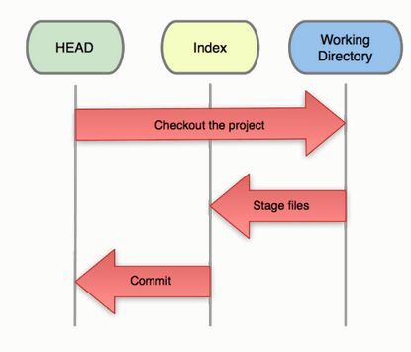
Git Concept: Head, Index, Working
REF: https://Git-scm.com/blog
HEAD is the snapshot of your last commit.
Index is the snapshot of your next commit.
Working Directory is your scratch space, used to easily modify file content.

Slide 11
TIY 5: Reset & Revert
Objectives
Reset
Revert

Slide 12
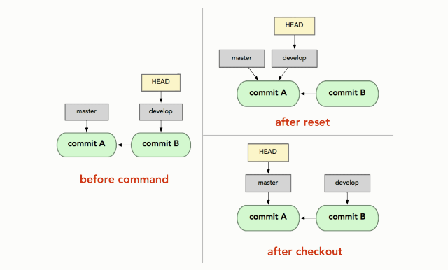
Git Concept: Head, Index, Working

Slide 13
TIY 6: GITHUB Concepts
Objectives
Fork
Pull Request

Slide 14
Recap
init
clone
log
status
diff
add
commit
merge
push
pull
reset
revert

Slide 15
What Next?
Git file structure aka the .git directory
Tags, Rebase
Hooks
Git Flows

